Slide 1

Gearbox +
Gearbox but better

Slide 2
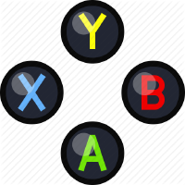
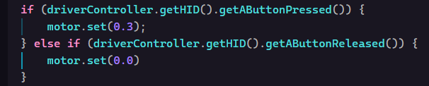
Using Buttons to spin motors
We can also use the pro gamer ABXY buttons on the controller to spin the motor instead of the joystick.
Notes:
Show how to bind motor behavior to button presses; onTrue and onFalse (mention other methods like whileTrue or toggleOnTrue but no examples needed)
Could demonstrate different speeds or directions on different buttons

Slide 3

Review: Encoders
In the last section, we learned how encoders can be used to find the current position of a motor
This returns the current motor position in rotations, which will be important for the next step

Slide 4
The Problem
Say we want to spin the motor an X number of rotations, like if we wanted to spin it +5 rotations or -3 rotations. How do you think we would do that?

Slide 5
The Solution
Step 1 is to find the targeted position. This is simply the position we are currently at plus the amount we want to spin. Remember, if we’ve already spun the motor, we aren’t starting at 0, so we need to add the amount we want to spin to the current position instead
Keep in mind, you also need to declare at the top of the class

Slide 6
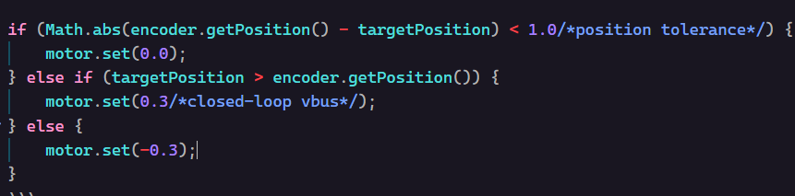
The Solution (cont.)
The second and final step is to get the motor to the target position. This involves multiple different control paths, and looks something like this:
If the distance to the target position is within the tolerance, stop the motor. Otherwise, move the motor toward the target position

Slide 7
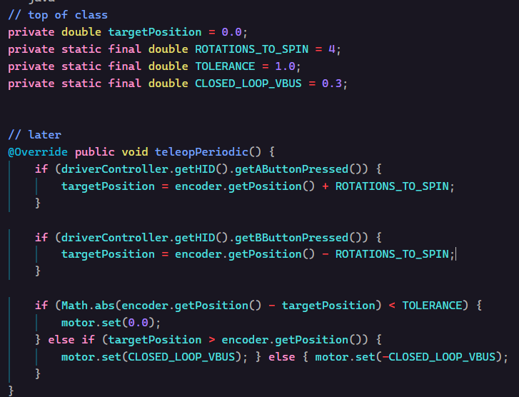
Putting it all together
Adding some new variables to keep track of constants, defining the methods, and binding to the controller, we end up with something like this:

